Slide 1
Line Followers: Basic to PID
By Sanjay and Arvind Seshan

Slide 2
Lesson Objectives
Evaluate and compare different line followers
Prerequisites: Complete all Line Follower lessons on EV3Lessons.com, Calibration
Videos will not play in PDF

Slide 3
Which Program Works Best for Which Situation?
Simple Line Follower
Most basic line follower
Wiggles a lot due to sharp turns
Good for rookie teams → need to know loops and switches
Smooth Line Follower
Almost the same as simple
Turns are less sharp
Has trouble on sharp curves
Good for rookie teams → need to know loops and switches
3-Stage Follower
Best for straight lines
Droids do not recommend this. Just learn the proportional line follower.
Need to know nested switches
Proportional Follower
Uses the “P” in PID
Makes proportional turns
Works well on both straight and curved lines
Good for intermediate to advanced teams → need to know math blocks and data wires
Watch the videos on the next 2 slides to see all four.

Slide 4
Curved Line: Watch Videos
Simple Line Follower
Smooth Line Follower
3-Stage Follower
Proportional Follower

Slide 5
Straight Line: Watch Videos
Simple Line Follower
Smooth Line Follower
3-Stage Follower
Proportional Follower

Slide 6
Watch Videos
Proportional Follower
PID Follower

Slide 7
3 Line Follower Challenges
Challenge 1: Can you write a simple line follower? Hint: Review Beginner: Basic Line Follower lesson
Challenge 2: Can you write a smoother line follower? Hint: Change how sharp the turns are in a simple line follower.
Challenge 3: Can you write a three-stage line follower where the robot moves different 3 different ways (left, right or straight) based on the reading from the color sensor?

Slide 8
A Note About Our Solutions
CALIBRATE:
The programs use the EV3 Color Sensor in Light Sensor mode
You will have to calibrate your sensors.
Please refer to Intermediate: Color Sensor Calibration Lesson
PORTS:
The Color Sensor is connected to Port 3.
Please change this for your robot.
WHICH SIDE OF THE LINE:
Please take note of which side of the line the code is written for

Slide 9
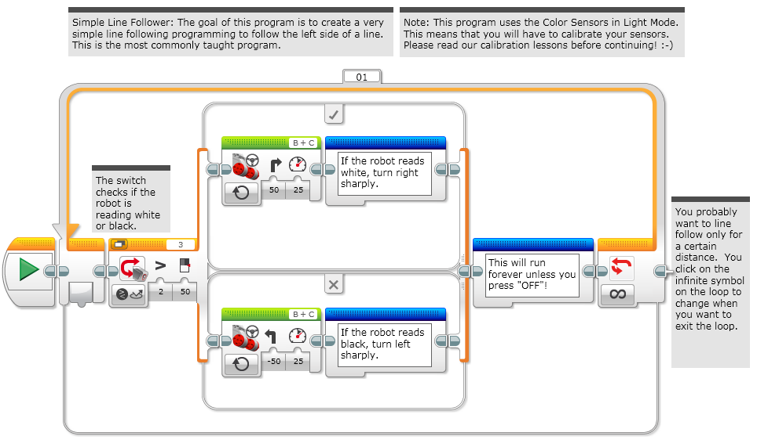
Simple Line Follower

Slide 10
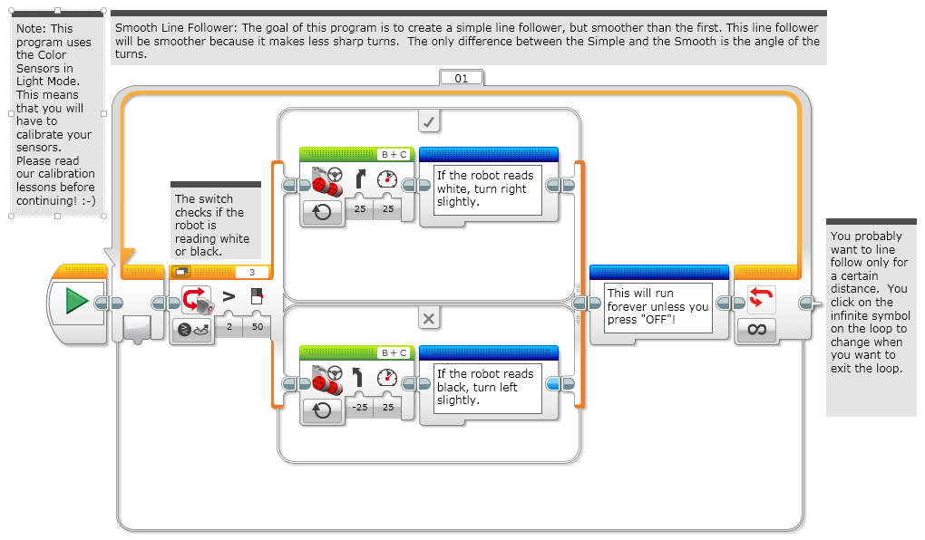
Smooth Line Follower

Slide 11
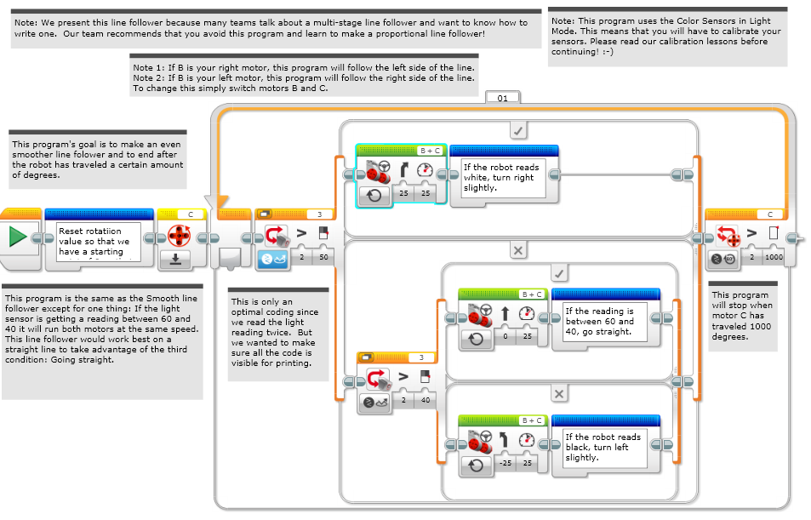
Three-Stage Line Follower

Slide 12
Proportional Pseudocode
Can you write a proportional line follower that changes the angle of the turn depending on how far away from the line the robot is?
Pseudocode:
Reset the Rotation sensor (Only required for line following for a total distance)
Compute the error = Distance from line = (Light sensor reading – Target Reading)
Scale the error to determine a correction amount. Adjust your scaling factor to make you robot follow the line more smoothly.
Use the Correction value (computer in Step 3) to adjust the robot’s turn towards the line.

Slide 13
Proportional Line Follower
Note: This program uses the color sensor in reflected light mode. You will need to calibrate your color sensor. If you do not know how to calibrate, please refer to our Calibration lesson.
Please refer to Proportional Control Lesson for more details
Reset the rotation sensor
Part 1: Compute the Error
Our goal is to stay at the edge of the line (light sensor = 50)
Part 2: Apply the correction
The error in part 1 is multiplied by a Constant of Proportionality (0.7). This will be different for each robot/application. See slides 9-11 to learn how to tune this number.
This line follower ends after 1000 degrees. Change this to suit your needs.

Slide 14
PID Pseudocode
Take a new light sensor reading
Compute the “error”
Scale error to determine contribution to steering update (proportional control)
Use error to update integral (sum of all past errors)
Scale integral to determine contribution to steering update (integral control)
Use error to update derivative (difference from last error)
Scale derivative to determine contribution to steering update (derivative control)
Combine P, I, and D feedback and steer robot

Slide 15
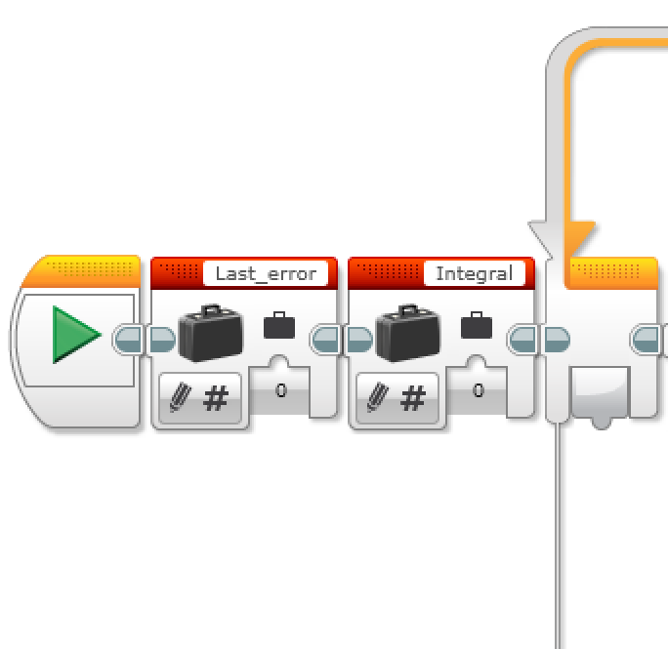
PID Code
Refer to PID lesson for more details
Set up the variables for the last error and integral before the loop and initialize to 0 because they are read before being written.
Code has been split for readability. Continues below.
Proportional
Integral
Derivative
Putting it all Together

Slide 16
Evaluating Line followers
Proportional
PID
Uses the “P” in PID
Makes proportional turns
Works well on both straight and curved lines
Good for intermediate to advanced teams → need to know math blocks and data wires
It is better than proportional control on a very curved line, as the robot adapts to the curviness
However, for FIRST LEGO League, which mostly has straight lines, proportional control can be sufficient

Slide 17
Credits
This tutorial was created by Sanjay Seshan and Arvind Seshan
More lessons at www.ev3lessons.com
This work is licensed under a Creative Commons Attribution-NonCommercial-ShareAlike 4.0 International License.

