Slide 1
EV3 Classroom: Line Followers: Basic to PID
By Sanjay and Arvind Seshan

Slide 2
Lesson Objectives
Evaluate and compare different line followers
Prerequisites: Complete all Line Follower lessons on EV3Lessons.com, Calibration
Videos will not play in PDF

Slide 3
Watch Videos
Simple Line Follower
Simple Line Follower
Proportional Follower
PID Follower

Slide 4
A Note About Our Solutions
CALIBRATE:
The programs use the EV3 Color Sensor in Reflected Light mode
You will have to calibrate your sensors.
Please refer to Intermediate: Color Sensor Calibration Lesson
PORTS:
The Color Sensor is connected to Port 3.
Please change this for your robot.
WHICH SIDE OF THE LINE:
Please take note of which side of the line the code is written for

Slide 5
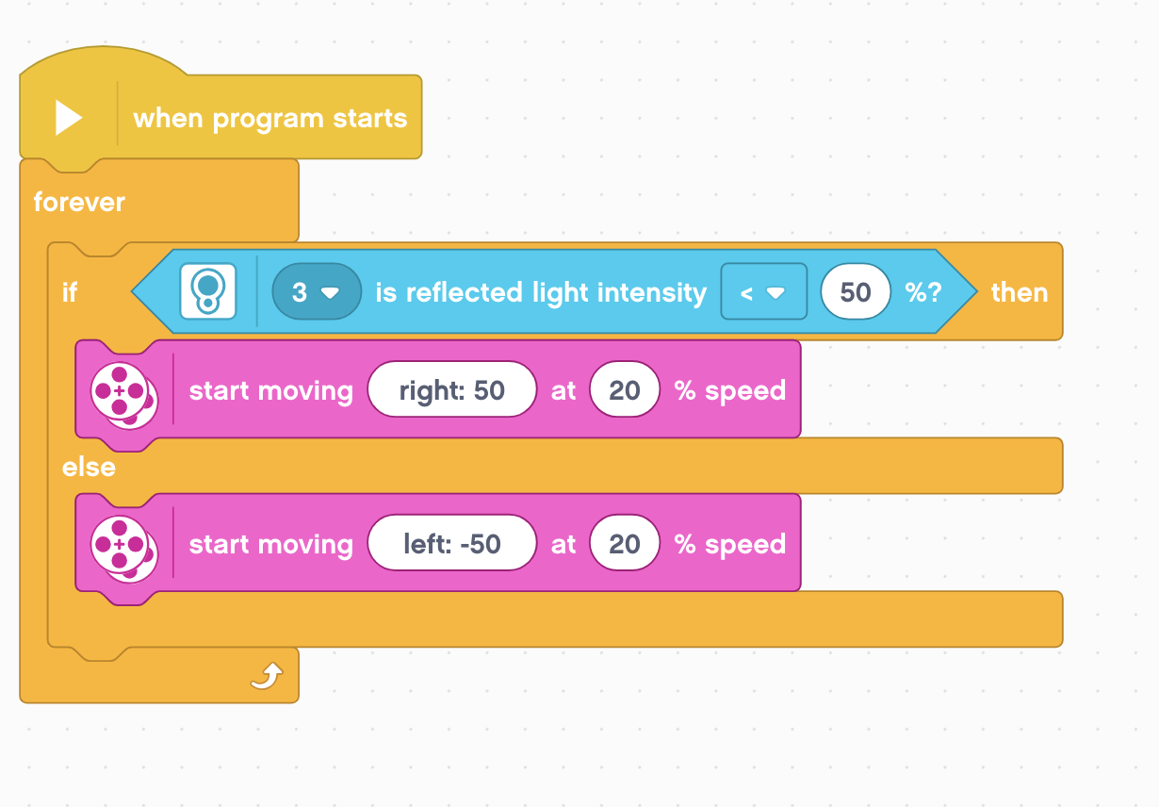
Simple Line Follower
Simple Line Follower
Most basic line follower
Wiggles a lot due to sharp turns
Good for rookie teams → need to know loops and switches

Slide 6
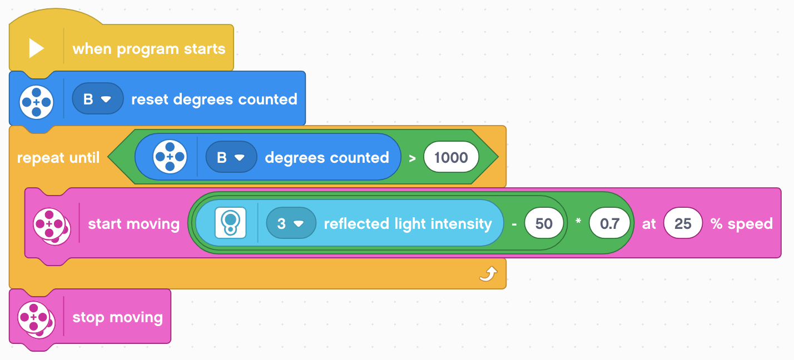
Proportional Line Follower
Please refer to Proportional Control Lesson for more details
Uses the “P” in PID
Makes proportional turns
Works well on both straight and curved lines
Good for intermediate to advanced teams → need to know math blocks and data wires

Slide 7
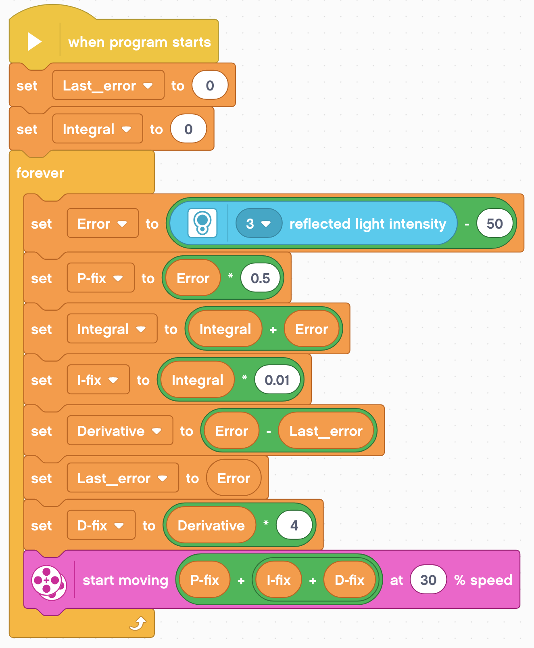
PID Code
Refer to PID lesson for more details
It is better than proportional control on a very curved line, as the robot adapts to the curviness
However, for FIRST LEGO League, which mostly has straight lines, proportional control can be sufficient

Slide 8
Credits
This tutorial was created by Sanjay Seshan and Arvind Seshan
More lessons at www.ev3lessons.com
This work is licensed under a Creative Commons Attribution-NonCommercial-ShareAlike 4.0 International License.

