Slide 1
BEGINNER PROGRAMMING LESSON
EV3 Classoom:
Updating Your Software and Firmware

Slide 2
LESSON OBJECTIVES
Learn how to update the software
Learn how to update the firmware

Slide 3
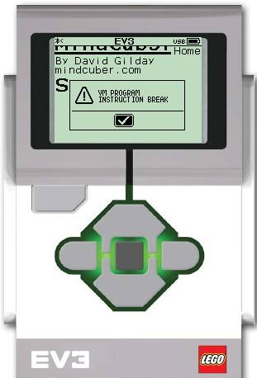
Why bother with updates?
When you first receive your EV3, you should update both your EV3 software and brick firmware versions.
Many users continue to run the default software and firmware versions.
There have been important bug fixes and new features since the EV3 first came out.
For example, the VM Program Instruction Break error was resolved in the last update in 2016.

Slide 4
NOTE: Two EDITIONS
There are two different EV3 brick firmware and programming software available: Home and Education Editions
To learn about the differences between the two, read http://ev3lessons.com/2017/01/17/Home-vs-Edu.html
Home Edition
Education Edition

Slide 5
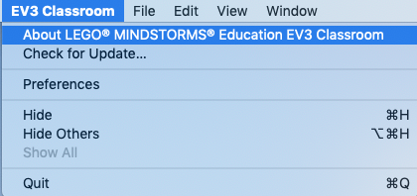
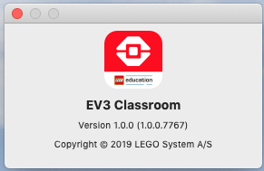
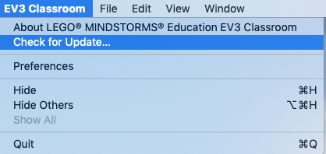
To update your SOFTWARE
Open the EV3 Programming Software you installed earlier
From the Menu, pick “About LEGO MINDSTORMS EV3”
A pop-up window will appear, showing the version of the software you are running
Click on the “Check for Update…” menu item to see if there is a newer version of the software

Slide 6
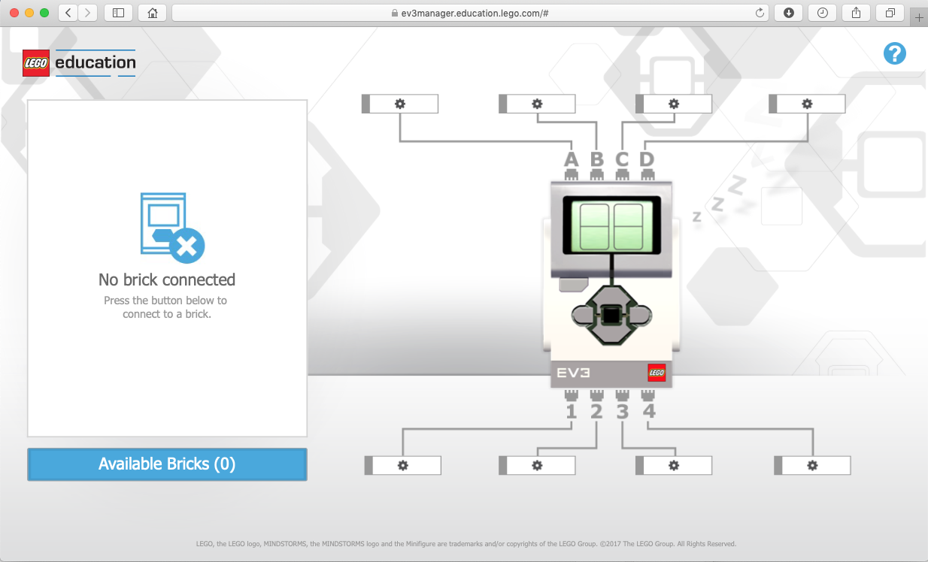
Updating Brick Firmware
The current EV3 Scratch software does not support updating brick firmware
To update firmware go to:
https://ev3manager.education.lego.com/
Download and Install EV3DeviceManager when prompted

Slide 7
Updating Brick Firmware
Once the EV3DeviceManager is installed the Web page should show connected devices and firmware version
Note that this only works with usb connected bricks. You may need to refresh the page and/or disconnect+reconnect the brick after you install the software to see this screen
Click on the update firmware if needed

Slide 8
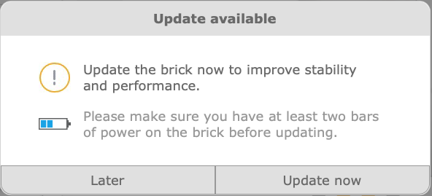
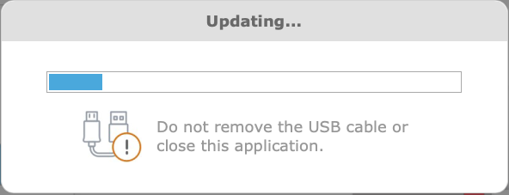
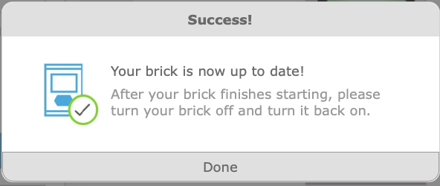
Updating Brick Firmware
You should see the dialog boxes on the left as part of the update process.
Follow the instructions given (e.g. click Update now)
At the end of the process, you will need to power cycle the brick to get it to connect to your computer

Slide 9
CREDITS
This tutorial was created by Sanjay Seshan and Arvind Seshan
More lessons are available at www.ev3lessons.com
This work is licensed under a Creative Commons Attribution-NonCommercial-ShareAlike 4.0 International License.

