Slide 1
Introduction to EV3Dev: Setup with Python

Slide 2
Objectives
Learn how to install ev3dev on an EV3
Setup Visual Studio Code IDE
Prerequisites: none

Slide 3
Materials
EV3 brick
USB Download Cable
Micro SD card (between 2gb and 32gb, preferably class 8+)

Slide 4
What is ev3dev?
ev3dev is a Debian Linux-based operating system that runs on the LEGO® MINDSTORMS EV3
ev3dev allows you to program in different languages (eg. Python, C++)
This will also cover installation of Python IDE (Integrated Development Environment)
Note that an IDE is not required to write or run ev3dev or Python code on the EV3
While you can edit Python code in any editor, an IDE simplifies various aspects of developing and managing your code.

Slide 5
Step 1: Download ev3dev
Download the latest version of EV3dev for EV3: https://www.ev3dev.org/downloads/
Download ev3dev-stretch beta as that is what is needed for usage with the IDE
For a detailed explanation of the differences between ev3dev-jessie and ev3dev-stretch, see the next slide
Remember where you downloaded the file

Slide 6
ev3dev-jessie vs. ev3dev-stretch
ev3dev-jessie:
Programs (and motors, sound, etc.) don't stop when you press the back button (unless you write your program in such a way that it does this, which is not exactly easy to do right)
Doesn't work with VS Code extension
Battery monitor does not automatically turn off the brick to prevent battery damage
ev3dev-stretch:
Programs (and motors, sound, etc.) should stop when you press the back button.
Does work with VS Code extension.
Battery monitor automatically turns of brick when it reaches too low a voltage
ev3dev2 python package is available, which is easier to use (e.g. it has move steering/move tank type functions)
Stretch is recommended for FIRST LEGO League teams because of the support for the IDE and the ev3dev2 library

Slide 7
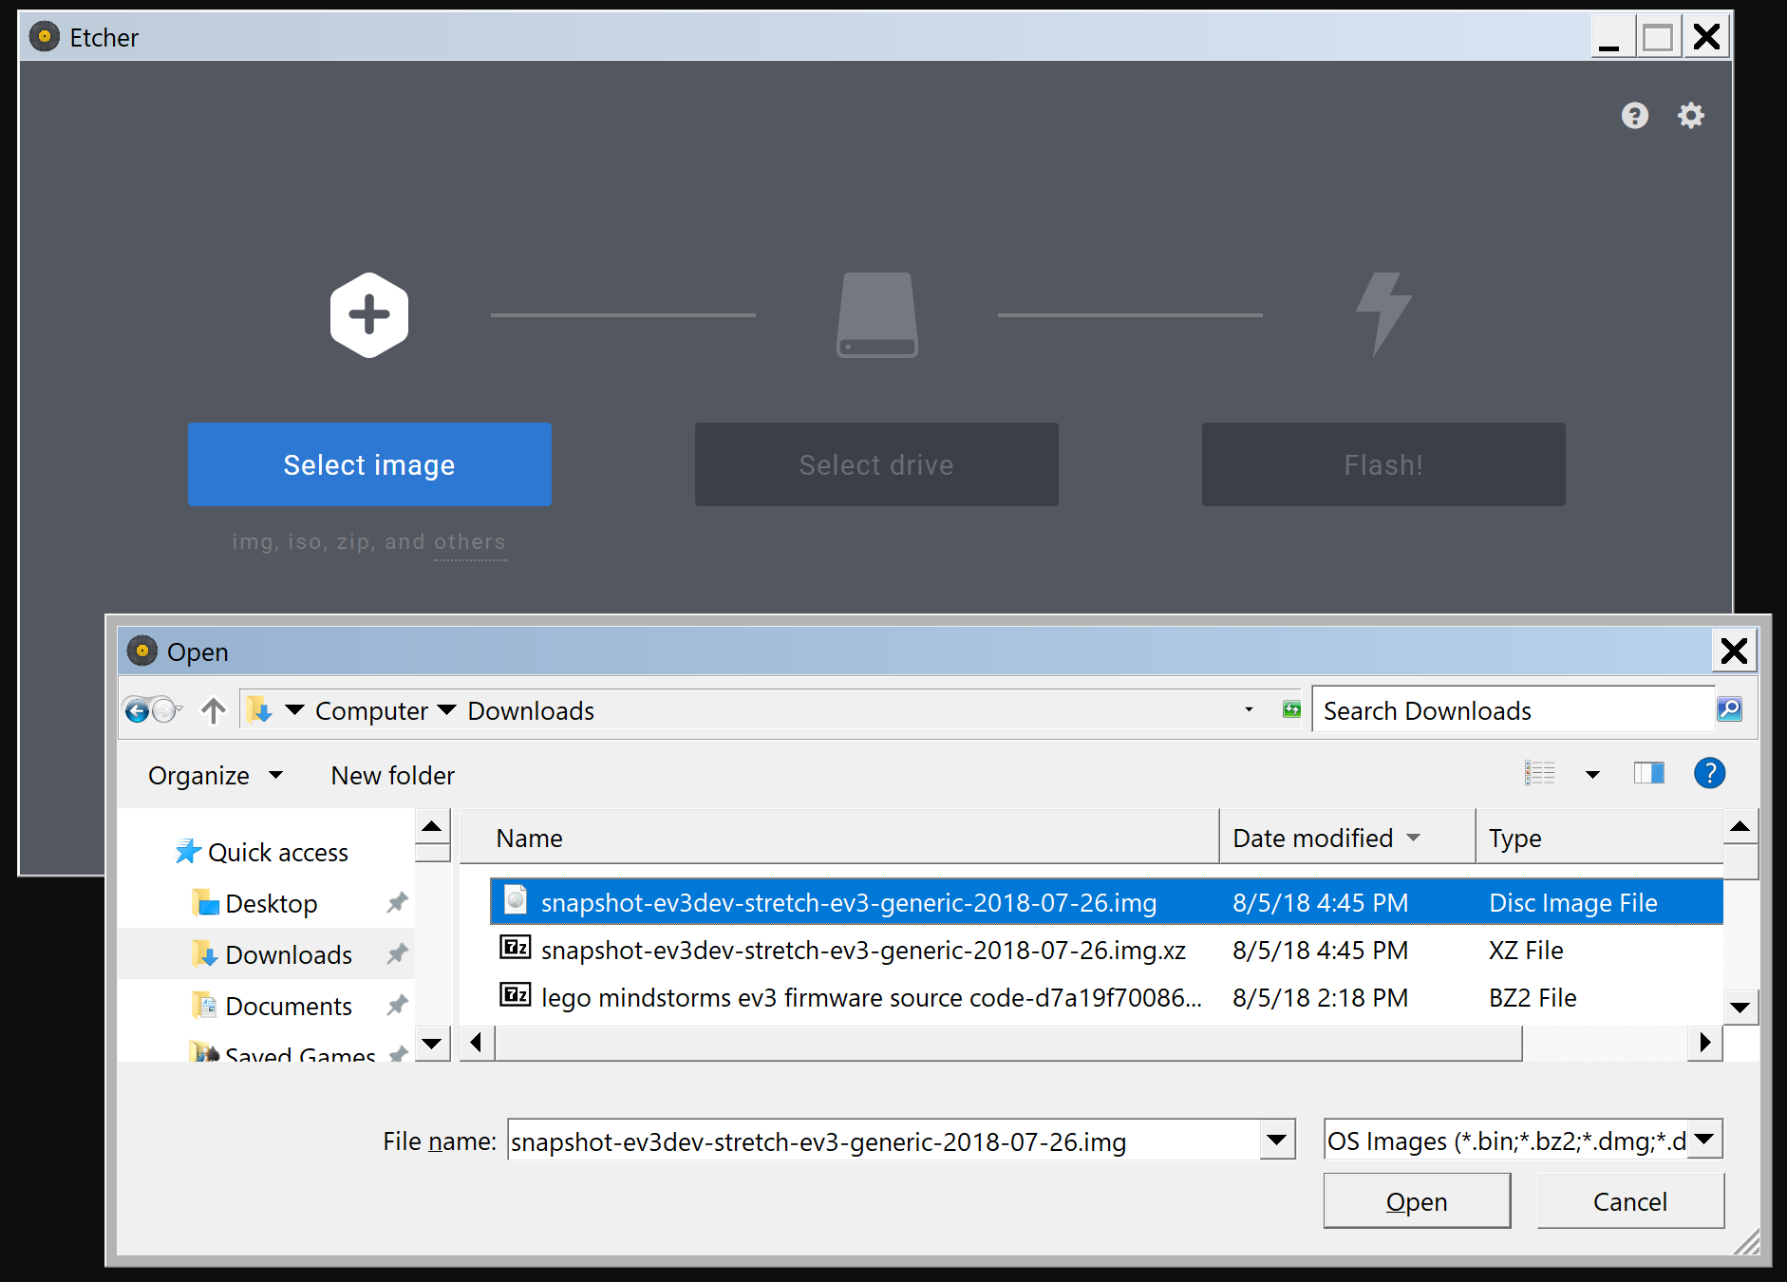
Step 2: Write Image (Windows, Mac, Linux)
If you have a favorite tool writing images to SD cards – use that. Otherwise, we recommend that you download and install Etcher: https://etcher.io/ for your OS
Select the downloaded file for writing
Insert the Micro SD card into the computer
Write to your SD card (in device dropdown)

Slide 8
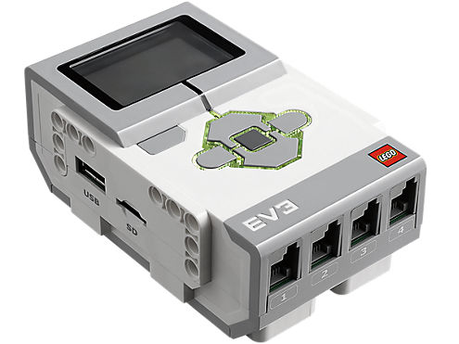
Step 3: Boot ev3dev
Put the SD Card in your EV3 and power it on.
At first, you will see the MINDSTORMS boot screen and the red LEDs will be on. This is immediately followed by the ev3dev boot screen and the LEDs changing to orange.
The LED button lights on the EV3 brick will blink to indicate SD card activity.
Tip: The SD card can be hard to pull out. Create a little tab out of tape. (Remove tape prior to an FLL tournament.)

Slide 9
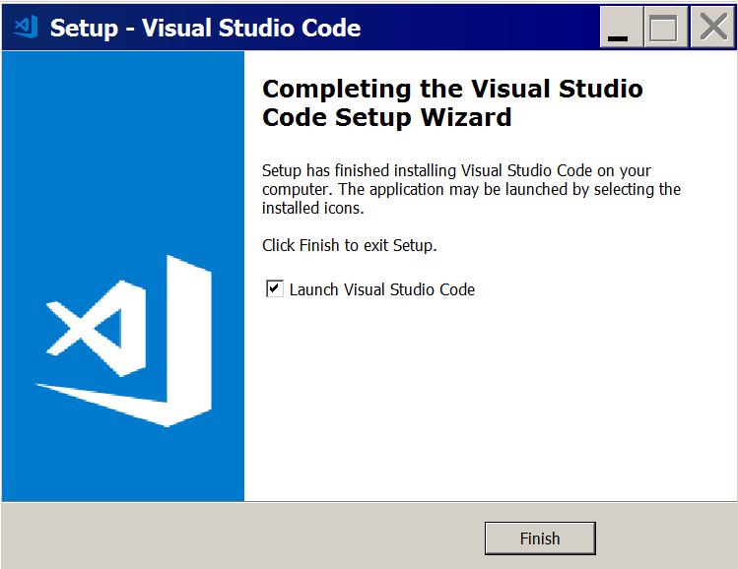
Step 4: Install Visual Studio Code (VSC)
Download and install VSC from https://code.visualstudio.com/ for Mac, Windows, or Linux.
This is the IDE that you can use to manage your programs.

Slide 10
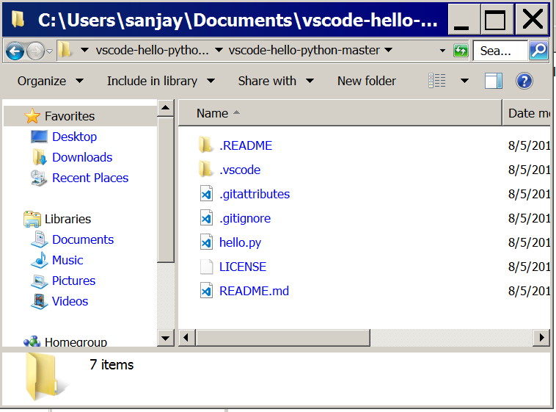
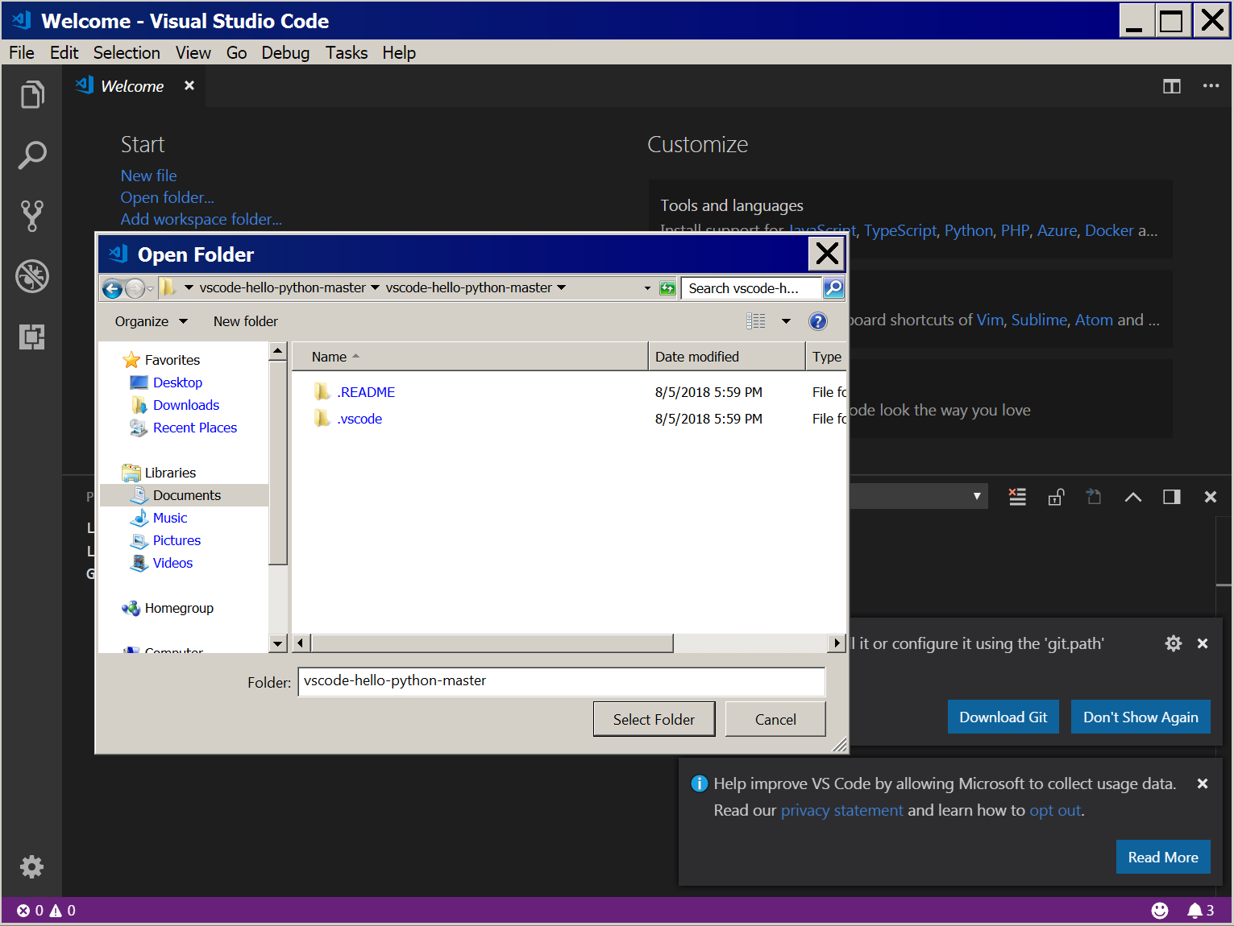
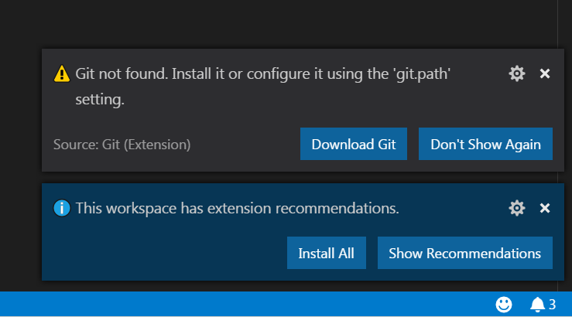
Step 5: Download Sample Project
Download and extract the following zip file: https://github.com/ev3dev/vscode-hello-python/archive/master.zip
Open the folder in VSC
You will see an alert “This workspace has extension recommendations” → Press “Install All”. You might afterward be prompted to install pylint → click install
Optional: If you want software versioning control, you can also install Git. VSC integrates with Git nicely.

Slide 11
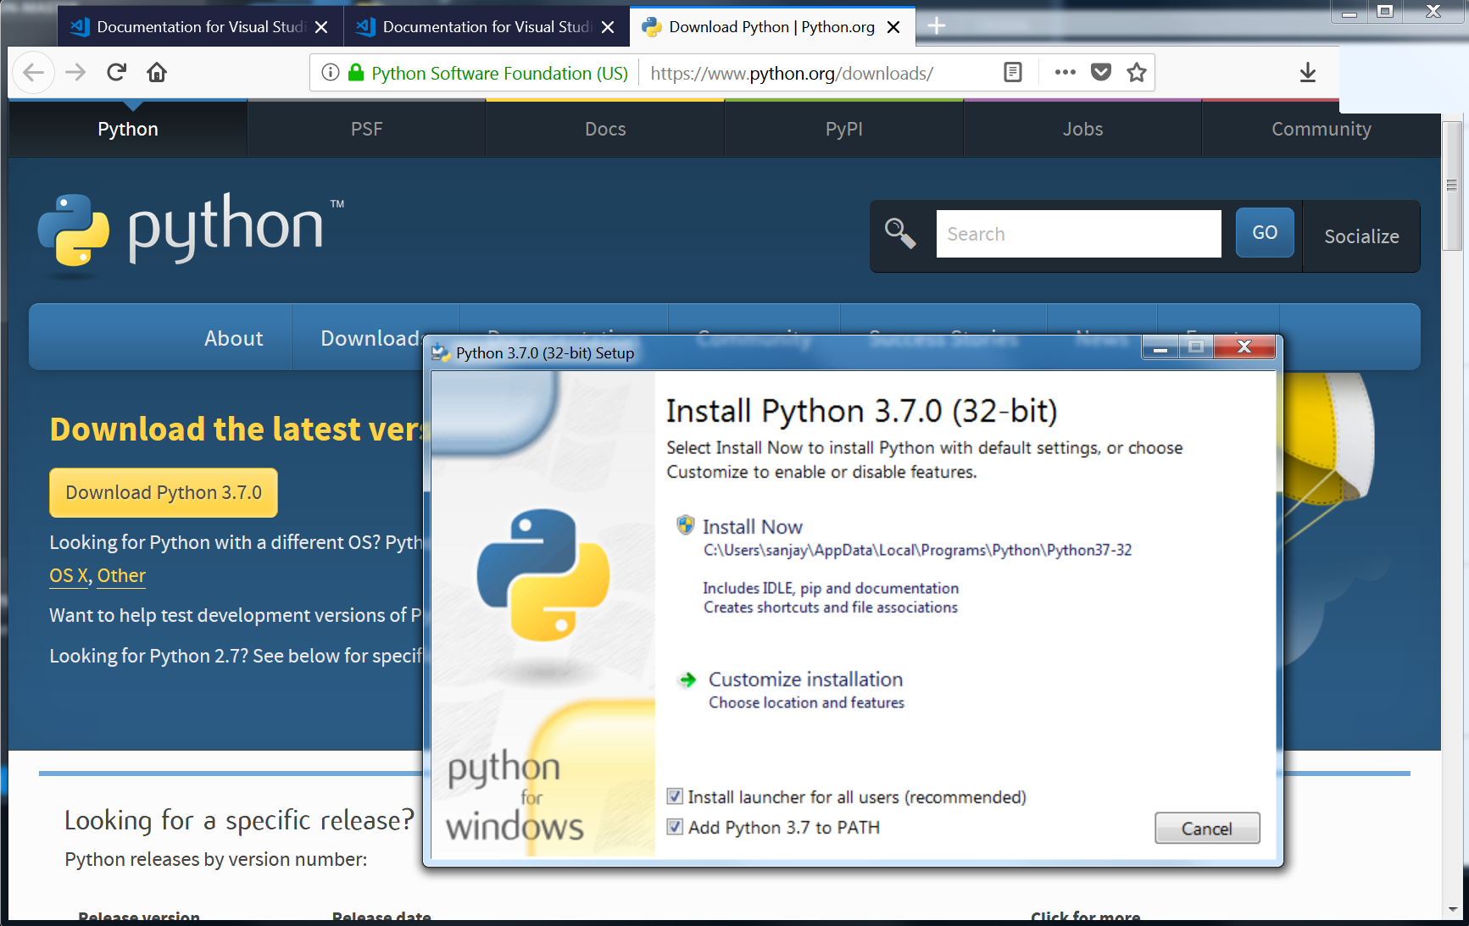
Step 6: Install python 3
Download and install python3 from: https://www.python.org/downloads/
You won’t be running python on your desktop but the IDE setup needs this

Slide 12
Step 7: Connect to EV3dev
Click on File Browser
Then click “Click here to connect to a device” under EV3dev Device Browser
Plug in your EV3 via USB and you should be able to click on your brick in the new dialog
Note: if you connect your EV3 using WiFi or Bluetooth, you can connect to the brick by choosing “I don’t see my device” and entering an IP address

Slide 13
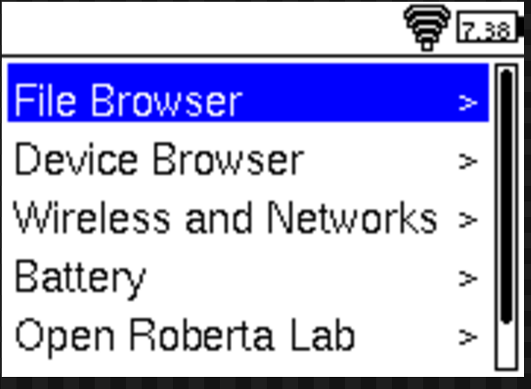
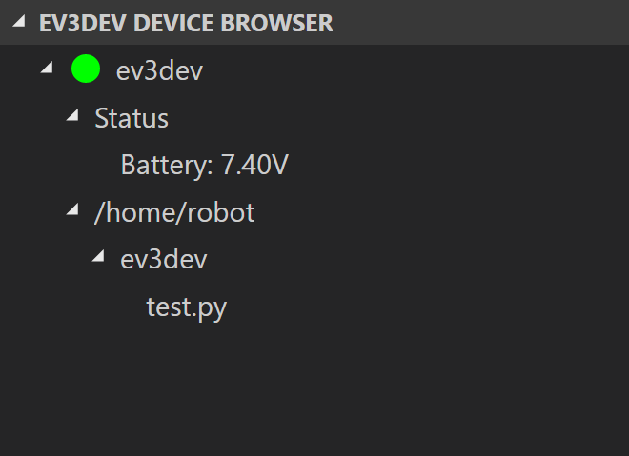
Step 8: Running Code
You can click on any file (or create a file) in the left pane to edit it in python
To run a program, click the debugger icon on the left-hand pane and press download and run
Programs can also be run directly on the brick under the “File Browser → ev3dev” on the robot’s Brick Manager

Slide 14
CREDITS
This tutorial was created by Sanjay Seshan and Arvind Seshan from EV3Lessons
More lessons are available at www.ev3lessons.com
Credits: David Lechner, ev3dev.org, for the valuable feedback and information used in the ev3dev-jessie vs stretch slide
This work is licensed under a Creative Commons Attribution-NonCommercial-ShareAlike 4.0 International License.

