Slide 1
Synchnonized Lights Using the RGB LED Strip Controller by Mindsensors.com

Slide 2
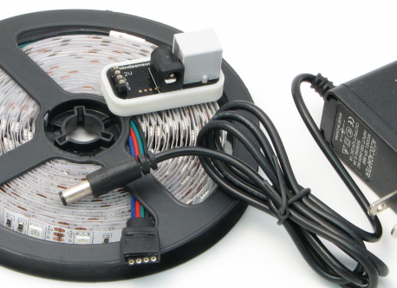
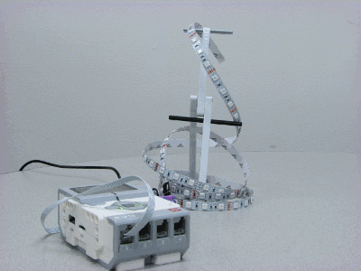
RBG LED Strip Controller
Purchase the RGB LED Strip Controller for EV3 or NXT from Mindsensors.com
Kit includes:
EV3Lights controller
5 Meter RGB LED strip
12V Power adapter
Notes:
Do not connect to motor port.
Do not use an input power supply greater than 12 volts DC.
Image credit: Mindsensors.com

Slide 3
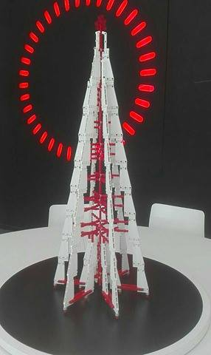
Project Description: Christmas Tree
Use the programmable LED strip and your EV3 to create an EV3-controlled Christmas Tree that is synchronized with music
Create a tree from LEGO (or use a real tree)
Weave the lights through the tree
Play some Christmas music near the sound sensor and have the lights flash
Have the lights randomly change colors
Photo credit: blast labs, Vassilis Chryssanthakopoulos

Slide 4
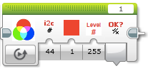
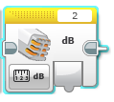
Download Blocks
If you need help, reviewing “Importing Third Party Blocks” lesson in Beyond on EV3Lessons.com
Download the Mindsensors EV3Lights Block for the lights for from the product page
http://www.mindsensors.com/products/182-ev3lights-rgb-led-strip-controller-for-ev3-or-nxt?search_query=RGB+led+strip&results=1
Download the NXT Sound Sensor Block from the LEGO.com page
https://www.lego.com/en-us/mindstorms/downloads

Slide 5
Understanding the Blocks
Mindsensors EV3Lights Block
Refer to the Introduction to Sound Sensor Lesson in Beginner if you need to learn to use the Sound Sensor block
Output indicates whether update was successful
Color
1= red
2 = green
3 = blue
Connection to brick – leave this with the default value
Intensity of the color (0-255)

Slide 6
Download Sample EV3Lights Program
The Sample Program can be useful to learn the basics.
http://www.mindsensors.com/index.php?controller=attachment&id_attachment=332
What does this code do?
The light will flash red, wait a second, turns off (level = 0)
This repeats for green and blue
The entire code repeats forever

Slide 7
FAQ
How do you turn off the lights?
Turn the intensity level to 0.
Note that it may blink each time you change colors. So, setting the value to 0 in a loop will cause flashing.
What does Intensity mean?
Perhaps you don’t want the colors on your tree to be as bright. Experiment with different intensity levels
Why do the lights sometimes not change colors/turn off?
You may need a short pause between multiple updates to the lights. Rapid updates (e.g. in a loop) sometimes cause an update to be skipped.
How do you get the colors other than Red, Green and Blue?
What about combinations of colors? Place multiple EV3Lights blocks next to each other. Can you make purple?

Slide 8
Create a MyBlock to Simplify Controls
Wait block at the start ensures that we don’t update the lights too rapidly. Reduces issue mentioned in FAQ.
Inputs: User can select which color to display (1-3) as well as intensity (0-255)
A loop at the end repeats the selection until it succeeds

Slide 9
MyBlock Continued
Inputs: User can request the choice of a random color and/or intensity. Random intensity range is set to 0-100 (because we preferred this range).

Slide 10
MyBlock Continued
Inputs: The random intensity is set to 0 about 10% of the time for variety.

Slide 11
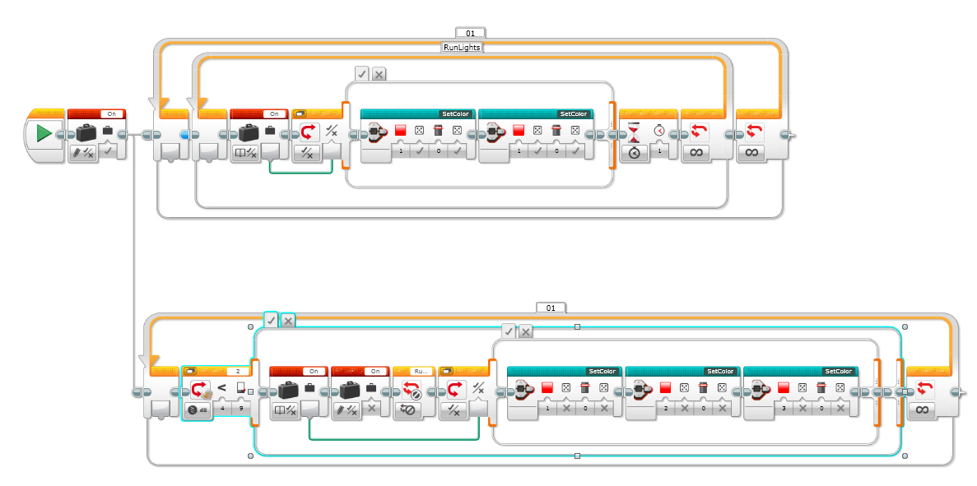
Synchronized Lights Code
Colors change every one second.
Uses two different light colors when the sound level is “on”
Turns off colors when the sound level is “off” (no music)

Slide 12
Next Steps: Ideas
Can you have the intensity of the lights change as you get closer to the tree using your ultrasonic sensor?

Slide 13
CREDITS
This tutorial was created by Sanjay Seshan and Arvind Seshan
More lessons are available at www.ev3lessons.com
This work is licensed under a Creative Commons Attribution-NonCommercial-ShareAlike 4.0 International License.

